Slide 1

Internship Program: Soulvibe.Tech
“Employees Dataset Analysis Using SQL”
Batch Name:Batch SVT/DAINT/2025/06/B09
Presented by: P.Naga Poornima Asritha

Slide 2

Introduction
.
Overview of main Objectives:
In this task, I worked on dataset containing Employee details in a company and asked to analyse the data using SQL. The Objective is to filter ,group, summarise, aggregate the data.This helps in understanding the complex relationships,meaningful insights and operational patterns in the data.I used SQL queries to explore these things.This will help to know the deep understandings in the data.

Slide 3
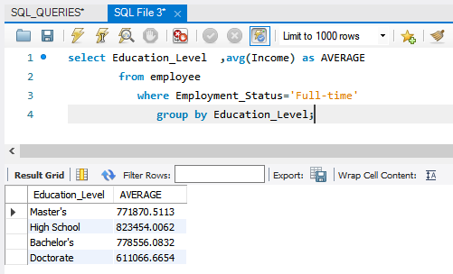
Retrieve the average income for each Education_Level for those who are
employed full-time.
1.

Slide 4
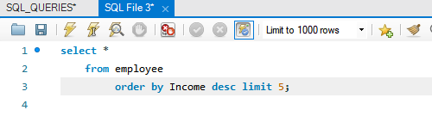
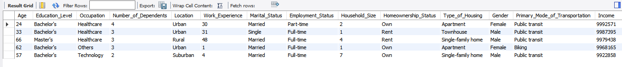
2.Retrieve the top 5 highest earning individuals and their details.

Slide 5
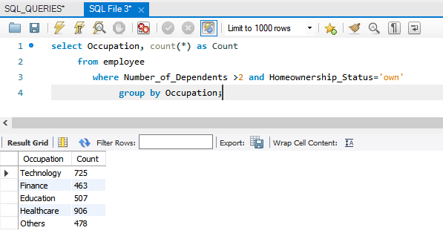
3.Retrieve Count of how many people in each Occupation have more than 2 dependents and own a house.

Slide 6
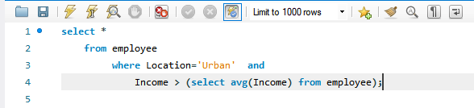
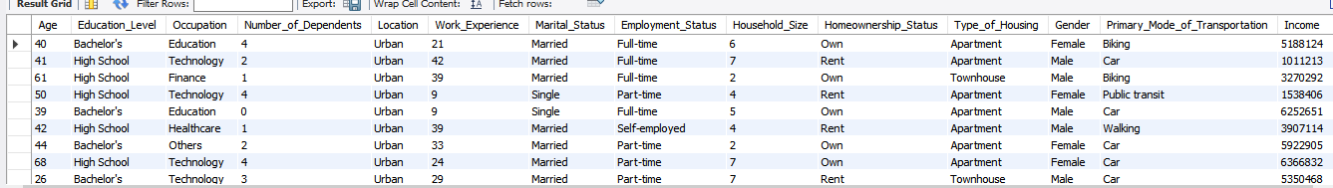
4.Retrieve the list of all individuals living in Urban locations with an income above the average income.

Slide 7
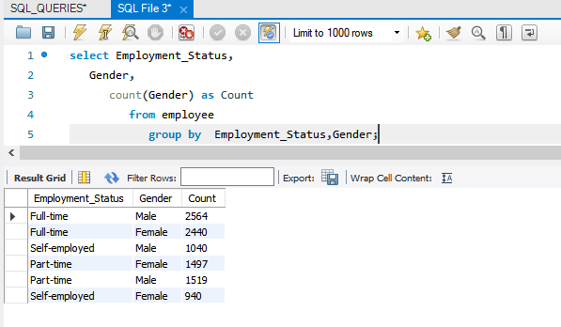
5.Retrieve the how many males and females are in each Employment_Status.

Slide 8
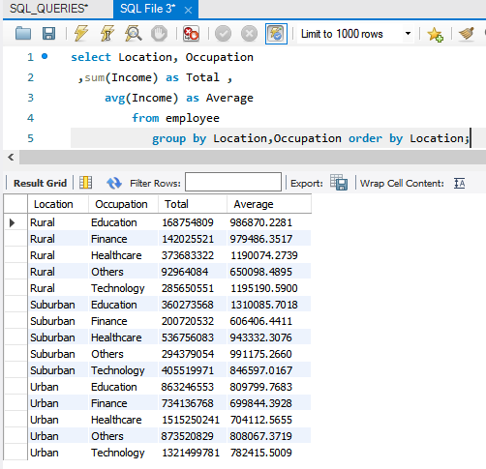
6.Retrieve that the total and average income by Location and Occupation.

Slide 9
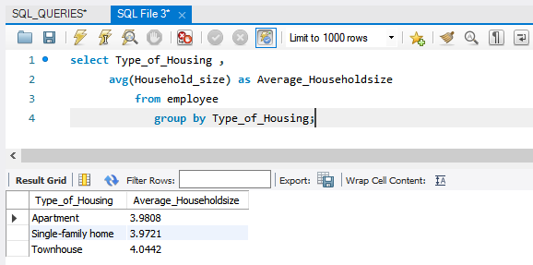
6.7.Retrieve the average Household_Size grouped by Type_of_Housing.

Slide 10
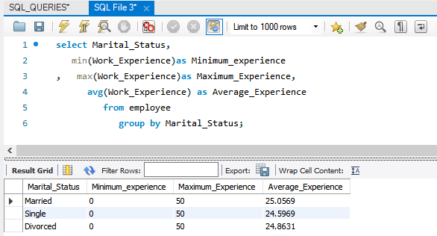
8.Retrieve the minimum, maximum, and average Work_Experience for each Marital_Status.

Slide 11
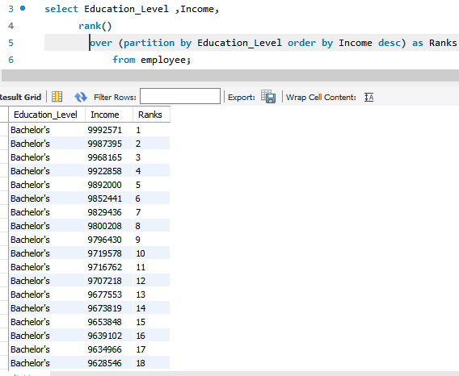
9.Retrieve the rank of individuals by Income within each Education_Level.

Slide 12
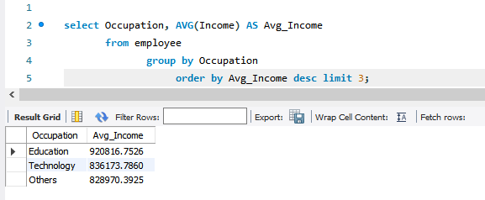
10.Retrieve the top 3 Occupation types with the highest average income.

Slide 13
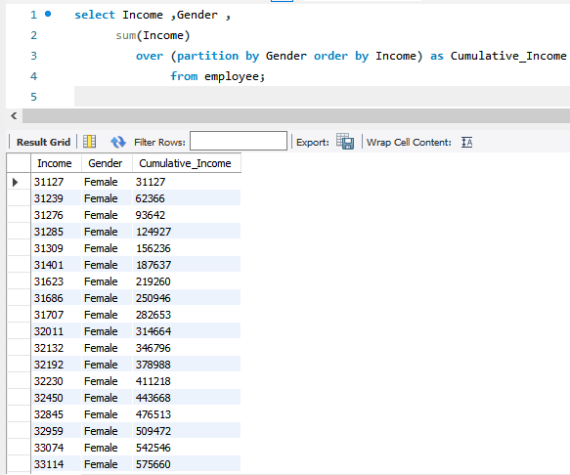
11.Use a window function to calculate the cumulative income for each Gender.

Slide 14
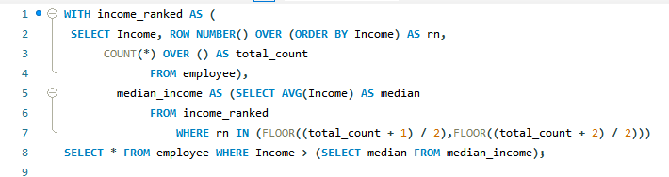
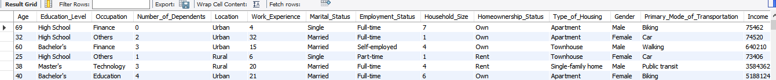
12.List the people whose income is above the median income for the dataset.

Slide 15


Conclusion
From this SQL-based exploration of the ‘employee’ dataset, I developed practical experience in analyzing workforce-related data using filtering, grouping, aggregation, and advanced window functions. By solving 12 analytical queries, I was able to :-
Understand income distribution across education levels and occupations.
Identify top earners and evaluate income inequality
Analyze workforce structure by gender, marital status, and employment status.
Leverage window functions for ranking and cumulative analysis.
Key Takeaways:
SQL is a versatile tool for data analysis in real-world HR and business datasets
Writing queries improved my understanding of data patterns, distributions, and relationships
Insights derived can be useful for policy planning, employee engagement strategies, and identifying high-income contributors
Advanced SQL functions like RANK() and window aggregates helped deepen analysis
This project strengthened my ability to extract meaningful insights from structured datasets for decision-making and reporting.

Slide 16
Thank You

